Slide 1
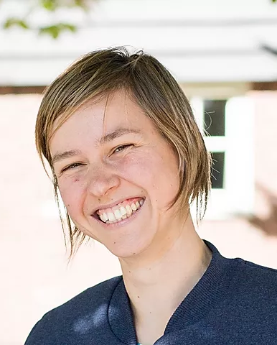
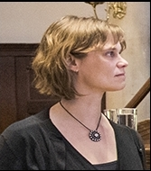
Award ceremony
June 16 – 2 TO 3 PM
COMMITTEE
And the nominees are:
Noa & Luuk (P3)
Puck & Sylvana (p9)
Imme & Pia (P5)
Anna & Noor (P8)
Irina & Mijke (P4)
Kiki & Lotte (P10)
EXPERIMENT ONTWERP
ABV1.2 2020
dr. Jolien Francken
dr. Natalie Cappaert
AND MORE…
PUBQUIZ

