Slide 1
Anger and Enthusiasm: MP’s politics of emotion in the UK
Haylee Kelsall

Slide 2
UK Politics…. Emotion laden (...lately?)
““I blame both sides
for boiling my choices down to
Project Fear
versus
Project Hate,”
(O’Brien, 2016, para. 1)

Slide 3
...avoid being “taken in”

Slide 4
avoid being “taken in”
by “the agents of Project Fear”

Slide 5
avoid being “taken in”
by “the agents of Project Fear”
“staying in the EU is the risky choice”

Slide 6
Saddiq Kahn to Johnson,
TV debate,
2 nights before referendum...
(In response…)

Slide 7
“...your campaign hasn’t been
Project Fear,
it’s been Project Hate,
as far as immigration is concerned,”

Slide 8
Post-referendum in The Guardian:
[The campaign was] “...characterised by
fear of immigration
[and]
anger over a perceived undemocratic bureaucracy,”
(Gabbatt, 2016, June 25)

Slide 9
“From May's tears to angry Trump,
is modern politics too emotional?”
(Hewitt, New Statesman article Oct, 2017)

Slide 10
Is this necessarily negative?
Emotionality improves democracy
Encourages political reasoning, attention (Marcus & Mackuen, 1993)
Stimulates participation (Valentino et al., 2010)
Anger is good for democracy
Rather than being apathetic, will express “Democratic anger” (White, 2012)
Mobilisation, participation
Participates as a result of anger, and effective? Confidence increases!

Slide 11
Is this necessarily negative… Continued
Idealistic democratic citizen:
Rational, logical
Relies on arguments of ‘logos’, reason
Instead of ‘pathos’ or ‘ethos’
BUT:
Politics is complicated
Electorate on average low in political knowledge
Heuristic cues (e.g. party cues)
Motivated reasoning and selective exposure...

Slide 12
Motivated Reasoning and Selective Exposure
Selective exposure - deliberate and non-deliberate
Deliberate, e.g. ideological media selectivity
Motivated reasoning - avoid cognitive dissonance
Seek information which confirms what we believe
Linked to motivated exposure (Iyengar & Hahn, 2009) motivated skepticism (Taber & Lodge, 2006)
⇒ Confirmation bias (seeking out confirming evidence)
⇒ Disconfirmation bias (counter-argue incongruent information, less critical of arguments in line with their opinion )

Slide 13
Selective Exposure: non-deliberate
Subconsciously based on the way we construct our (social) surroundings (Spohr, 2017)
Social networks: “homophilous” (McPherson & Cook, 2001)
Including online social-networks, like Twitter (Himelboim, McCreery & Smith, 2013)
Politically homogeneous clusters
Less cross-ideological content exposure
Sound familiar? Filter bubbles and echo-chambers….
Concerning, “News-finds-me perception” (de Zúñiga, Weeks & Ardèvol-Abreu, 2017)
News comes to me, so I don’t actively seek it - perceived well informed
Reality? Less politically knowledgeable, but less likely to seek as believe informed, and news comes to them already!

Slide 14
Emotion in political messages:
So far, minimal attention paid to Twitter communication
Campaign adverts, speeches
Emotions more likely to feature in speeches which intend to address public (Erisen & Villalobos, 2014).
But: Twitter = “Message multiplier” (Vaccari, 2013)
⇒ New journalistic beat (e.g. Moon & Hadley, 2013; Broersma & Graham, 2012)

Slide 15
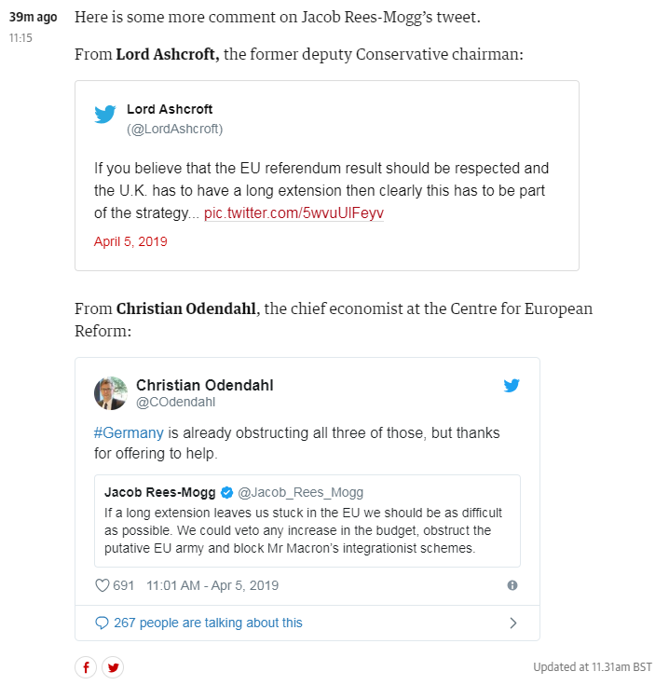
The Guardian 5th April, Politics Live Blog

Slide 16
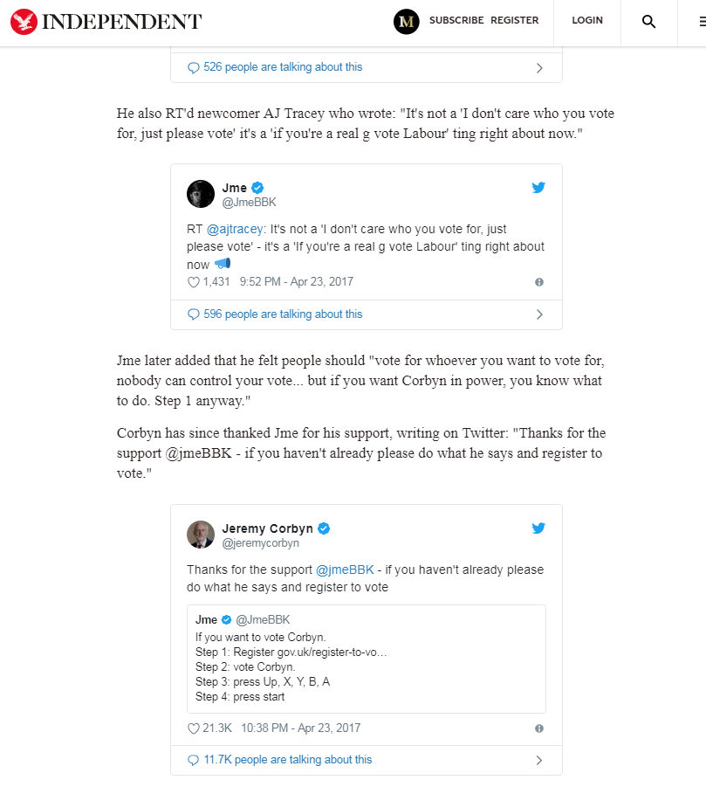
Monday, 24 April, 2017.

Slide 17
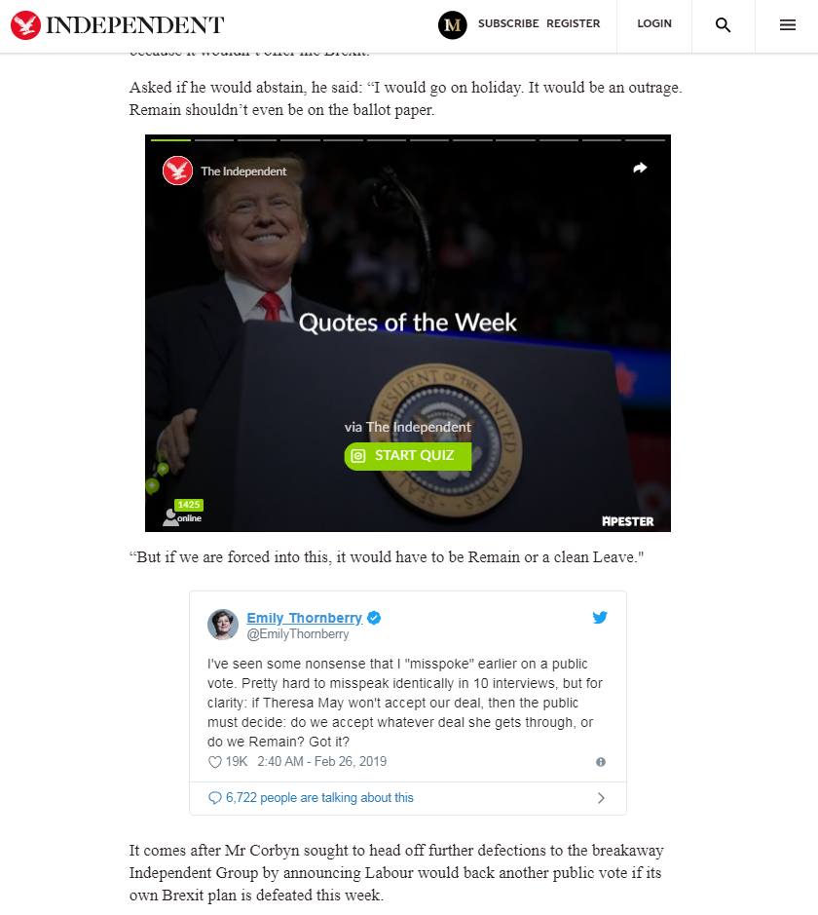
February 26, 2019.

Slide 18
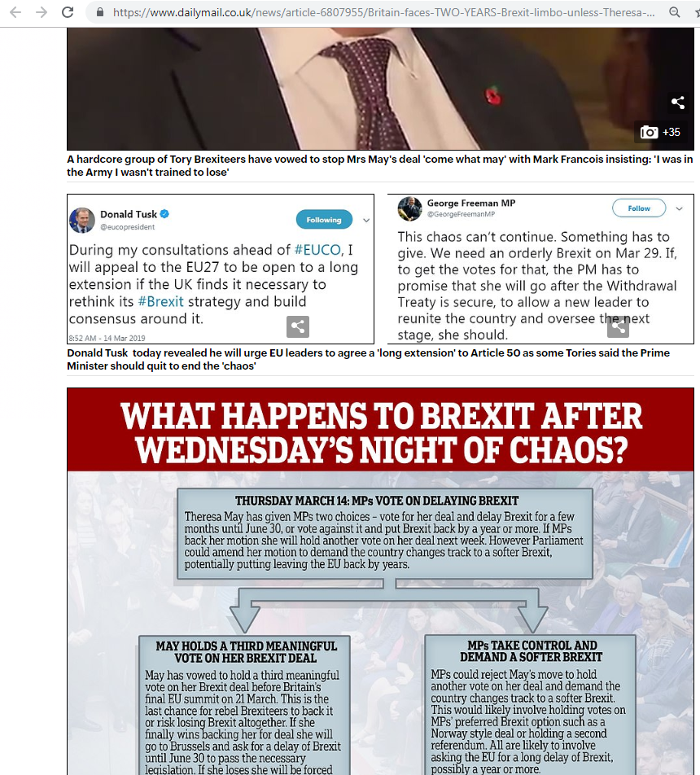
Daily Mail, 14 March 2019

Slide 19
Emotion in political messages:
So far, minimal attention paid to Twitter communication
Campaign adverts, speeches
Emotions more likely to feature in speeches which intend to address public (Erisen & Villalobos, 2014).
But: Twitter = “Message multiplier” (Vaccari, 2013)
⇒ New journalistic beat (e.g. Moon & Hadley, 2013; Broersma & Graham, 2012
Tweets reproduced VERBATIM: risk of reformulated messages by press decreases!

Slide 20
Research Question:
To what extent do political conditions influence
the use of anger and enthusiasm appeals employed by
UK politicians in their Twitter communications?

Slide 21
Why Anger and Enthusiasm?
Encourage similar behaviours, similar effects
Both shore up support, encourage participation
Most frequently used in campaign ads of positive vs negative (Ridout & Searles, 2011)
Leading candidates more enthusiasm
Trailing more anger
More competitive, more anger
Incumbents less likely re: anger, enthusiasm

Slide 22
Anger….
Political anger:
Where an individual believes harm/damage has been caused by a political actor, institution, or process, “...probably willingly or perhaps as the result of an action the bad consequences of which, it is thought, should have been foreseen” (White, 2012)
Encourages participation, cements partisan support….

Slide 23
Enthusiasm
Politicians need to generate enthusiasm for themselves/policy party amongst the electorate to gain support
“Rather than stopping, looking, and listening, enthusiasts throw themselves into the cause” (Marcus & MacKuen, 1993)
Shores up support (Brader, 2005)
Vote choice and intention (Marcus & MacKuen, 1993; Brader, 2005)
Stimulates participation, involvement, interest (Marcus & MacKuen, 1993; Marcus 2000; Brader, 2005; Valentino et al., 2010)
‘Cheap participation’ (e.g. bumper sticker, chatting)
Vs. Costly - rallies/donate/work for candidate - yes, but anger more so (Valentino et al., 2010)

Slide 24
Expectations, sub RQ’s: Issues
More complicated issues invite more emotional appeals
Why? Voters low in political knowledge, emotional appeals may give cues to voters
Example: Brexit - very complicated issue
Project Fear, Project Hate - evidence of emotional appeals
Post-referendum - “What is the EU”
Characteristic of a voter basing their choice on Logos? No.
However:
Very difficult to formulate hypotheses concerning particular issues!
RQ1: To what extent does the use of anger and enthusiasm appeals depend on the political issue concerned?

Slide 25
Expectations, sub RQ’s: Electoral Support: Party level
Larger support base: protect against defectors!
Mobilise supporters
H1: Political actors of the main centre-right and centre-left parties will use more enthusiasm and anger appeals than those of challenger parties

Slide 26
Expectations, sub RQ’s: Constituency level
Where a candidate has a large majority, or safe seat, more enthusiasm
More competitive electorates, more anger
H2a: Candidates which have an electoral majority in their constituency will make greater use of enthusiasm appeals, rather than anger
H2b: Candidates in more competitive electorates will make greater use of anger appeals than enthusiasm

Slide 27
Expectations, sub RQ’s: Party Hierarchy
Four levels identified in Benedetto and Hix (2007)
MP which holds ministerial position in cabinet or junior minister
MPs which have held some form of backbench office in the past (e.g. parliamentary committee, whip etc)
Former ministers
MPs not promoted to ministerial positions and have not held another sort of position

Slide 28
Expectations, sub RQ’s: Party Hierarchy
Four levels identified in Benedetto and Hix (2007)
MP which holds ministerial position in cabinet or junior minister
MPs which have held some form of backbench office in the past (e.g. parliamentary committee, whip etc)
Will use the most emotional appeals (H3)
Media attention, demonstrate importance to party
Safe seat = enthusiasm, demonstrate value to party (H3a)
Less safe seat - difficult to hypothesise…
Former ministers
MPs not promoted to ministerial positions and have not held another sort of position

Slide 29
Expectations, sub RQ’s: Party Hierarchy
Four levels identified in Benedetto and Hix (2007)
Remaining levels: Difficult to hypothesise expectations.
Level 1 - No clear expectations based on previous literature (this far)
Level 3 - perhaps more anger, related to blame (below)?
Level 4 - Again no clear expectation
However…
Post resignation….

Slide 30
How to measure?
Enthusiasm:
Proud, hope, and sympathy (Marcus & MacKuen, 1993)
Valentino et al., (2010) Self-report, has a candidate made you feel:
Pride, hope, (also anger)
Brader (2005) - four‐point scales for excitement and hope (Brader, 2005)

Slide 31
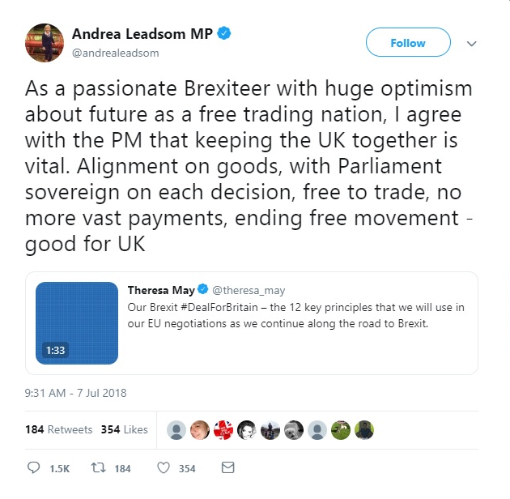
Enthusiasm
Words relating to hope, optimism etc.
Confidence
Based on Downs (1972) ‘issue-attention cycle’
Solutions

Slide 32
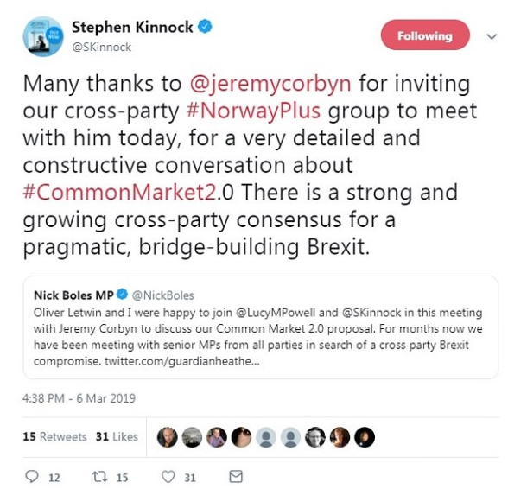
Enthusiasm
Words relating to hope, optimism etc.
Confidence
Based on Downs (1972) ‘issue-attention cycle’
Solutions

Slide 33
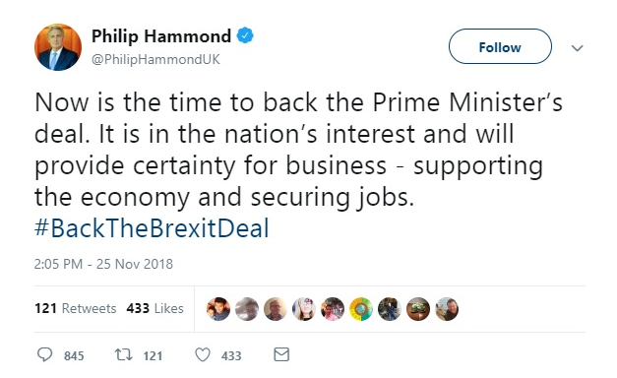
Enthusiasm
Words relating to hope, optimism etc.
Confidence
Based on Downs (1972) ‘issue-attention cycle’
Solutions

Slide 34
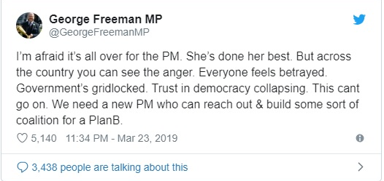
Anger, blame and referents…
Angry, negative words
Blame
I’m angry about…
I’m angry because….
I’m angry at…

Slide 35
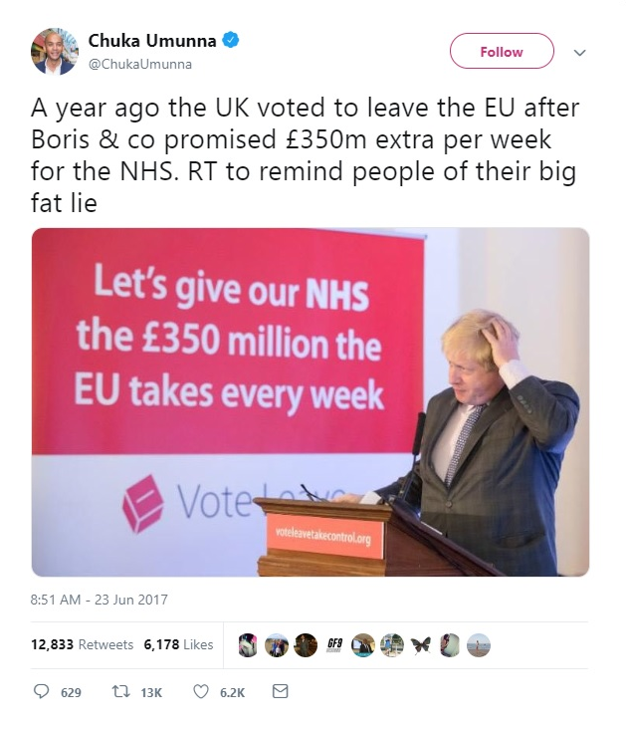
Anger, blame and referents…
Angry, negative words
Blame
I’m angry about…
I’m angry because….
I’m angry at…

Slide 36
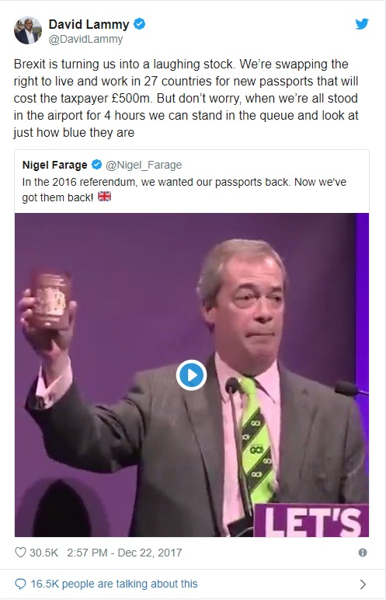
Challenges:
Sarcasm!
Confidence really evidence of solution-based enthusiasm?

Slide 37
Thoughts, comments questions?

